Slide 1
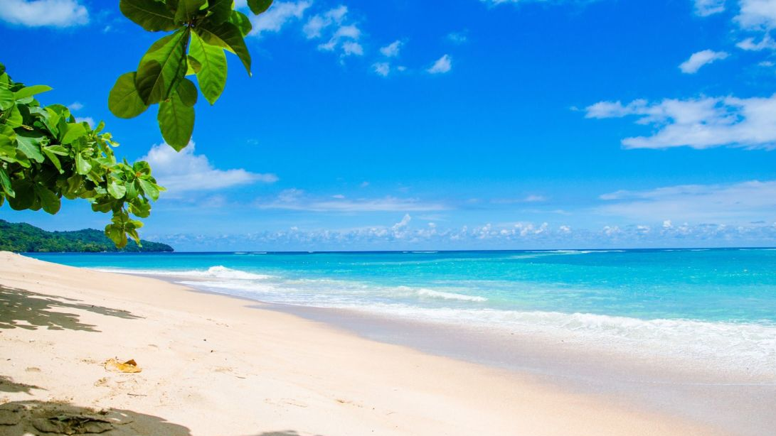
Summer Work
T Level Broadcast Media & Production
(Content Creation)

Slide 2

Welcome to T Level Broadcast Media & Production (Content Creation) Summer Work
Task: You are to choose from one of the 7 tasks below. This should only take you a maximum of 6 hours. Please do not spend more than the recommended time on this.
You must have this ready for your first week of the course, please make sure you bring this with you on your first day, ready to submit.

Slide 3
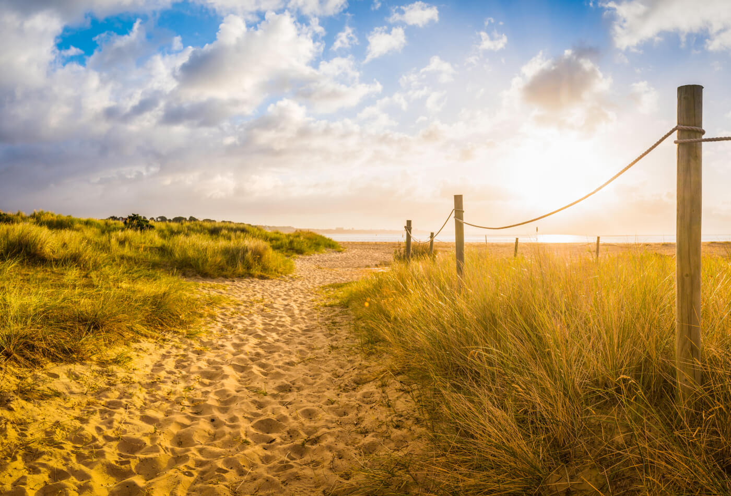
Mini Documentary Project
Task: Create a 3–5-minute mini-documentary on a local issue, cultural topic, or personal interest.
Focus Areas:
Storyboarding and scripting
Interviewing techniques
Basic B-roll and cutaway shots
Editing with transitions and titles

Slide 4

Social Media Content Series
Task: Create a themed series (e.g., “Behind the Scenes of My Summer”) with 5–10 posts for TikTok, Instagram Reels, or YouTube Shorts.
Focus Areas:
Hook and engagement techniques
Vertical framing and pacing
Call-to-actions
Basic analytics (track views/likes/comments)

Slide 5
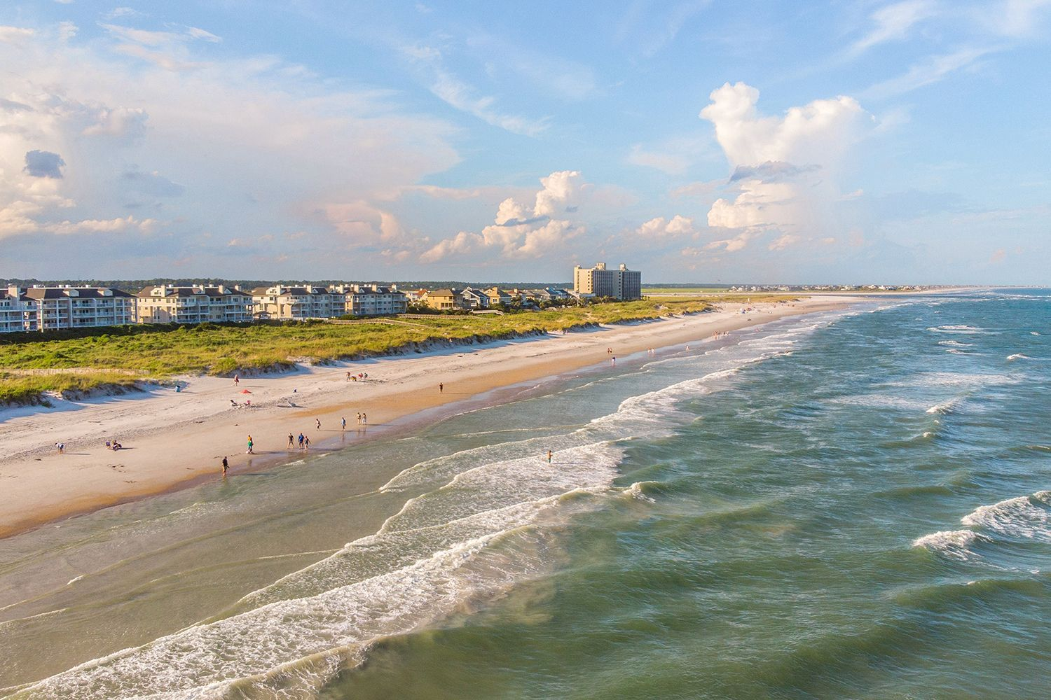
Create a Podcast Episode
Task: Plan, record, and edit a 3- 5-minute podcast episode. Topic can be music, gaming, news, or personal experiences.
Focus Areas:
Script structure (intro/middle/outro)
Voice clarity and tone
Music/sound effects
Editing in Audacity or similar software

Slide 6
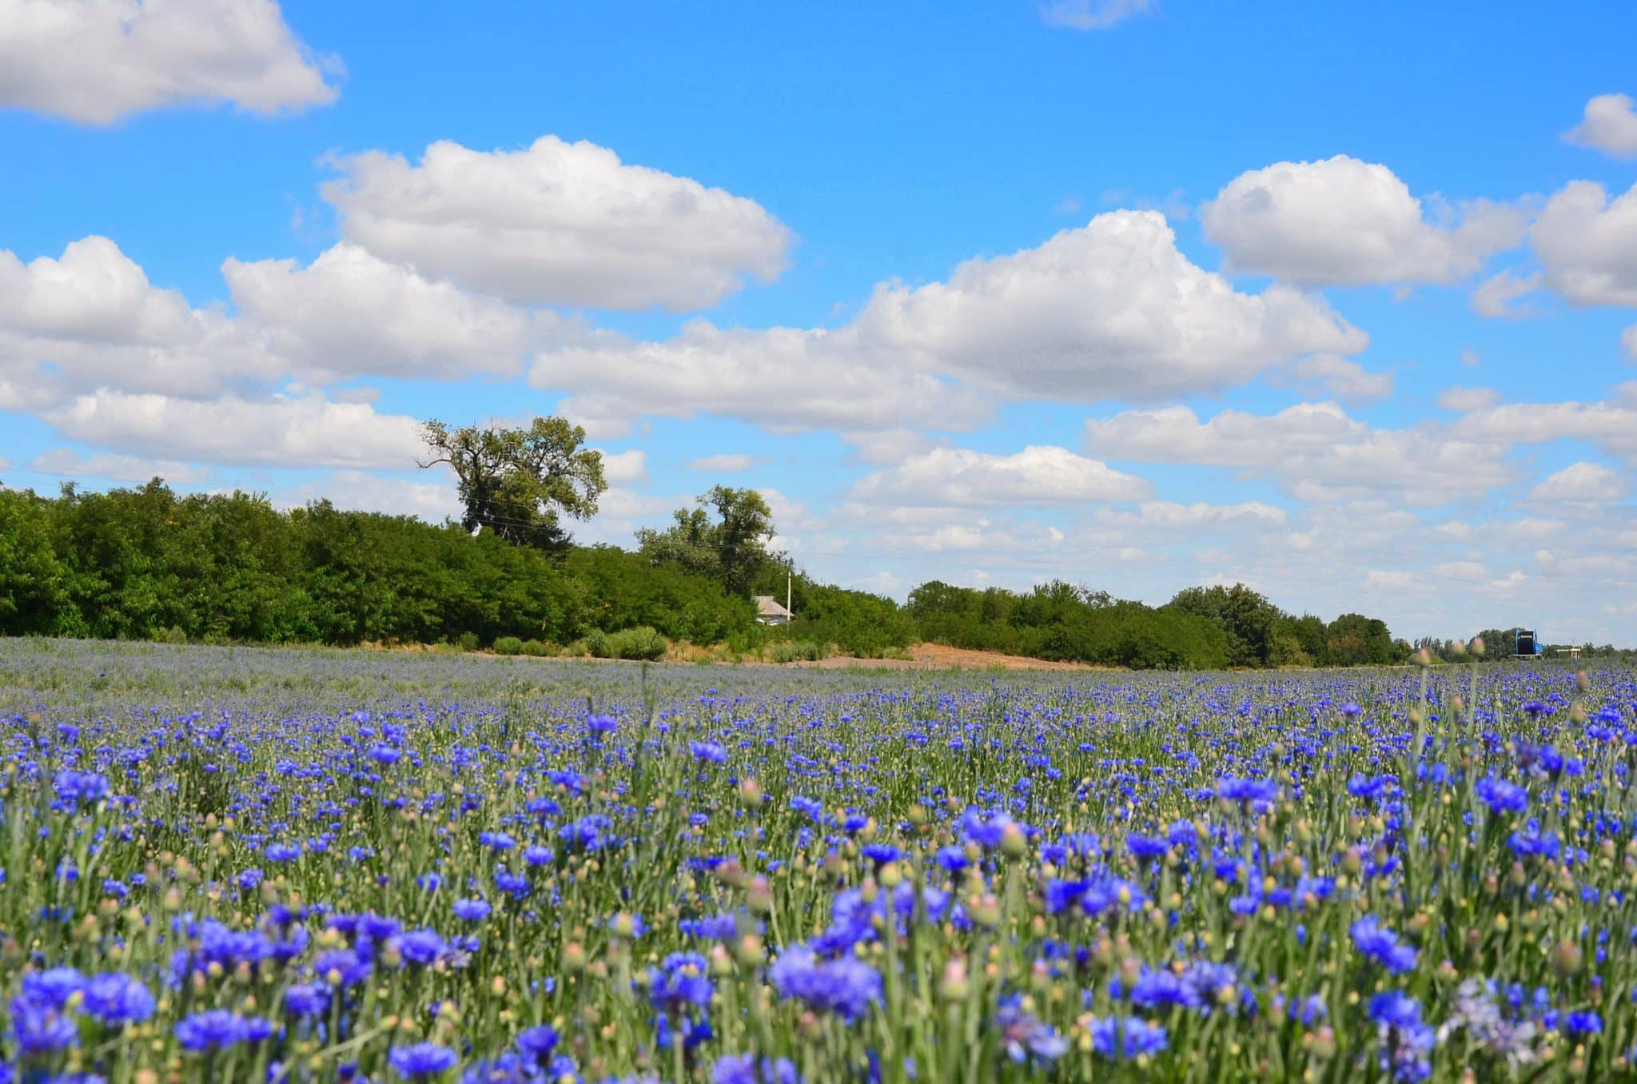
Visual Storytelling Photo Essay
Task: Capture a series of 10–15 photos telling a short story (e.g., "A Day in the Life", "Urban Nature", "My Hometown").
Focus Areas:
Composition, lighting, framing
Sequencing and flow
Captioning
Using Canva/PowerPoint

Slide 7
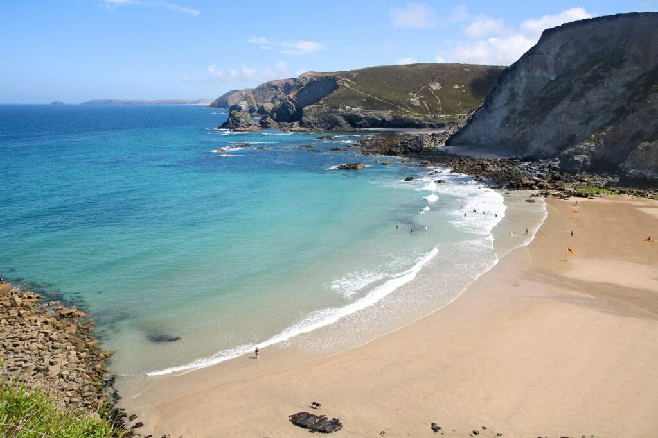
Recreate a Scene Challenge
Task: Choose a 1-minute scene from a movie or ad and recreate it as accurately as possible.
Focus Areas:
Camera angles, lighting, and framing
Set design and props
Timing and editing
Acting (or use voiceovers)

Slide 8
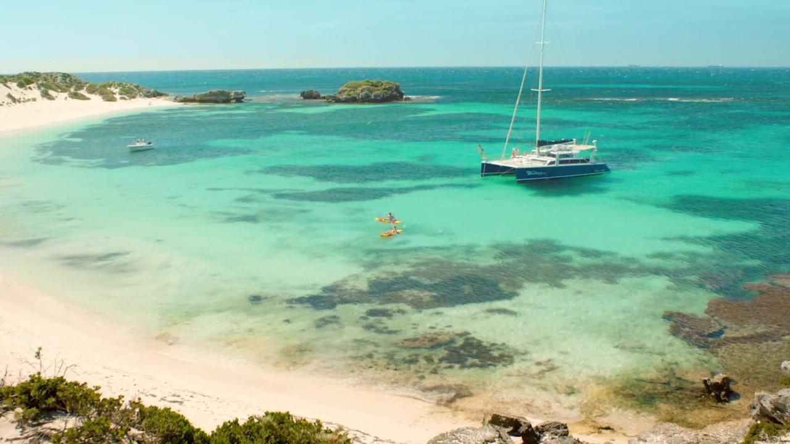
Create a News Package
Task: Produce a 2-minute video news package on a real or mock topic (e.g., local event, sports, or school news).
Focus Areas:
Newswriting and scripting
PTC (piece-to-camera)
Interviewing
Voice-over recording

Slide 9

Personal Creative Reel
Task: Compile the best bits from previous projects into a 1-minute reel to introduce yourself as a content creator.
Focus Areas:
Editing rhythm and music sync
Branding and style
Text overlays
Consistent aesthetic

